Slide 1

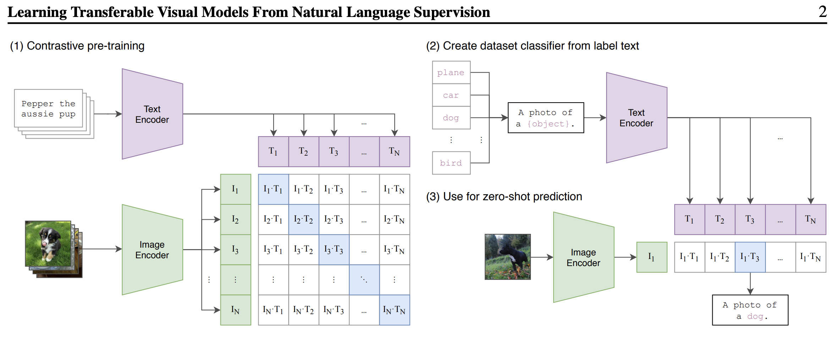
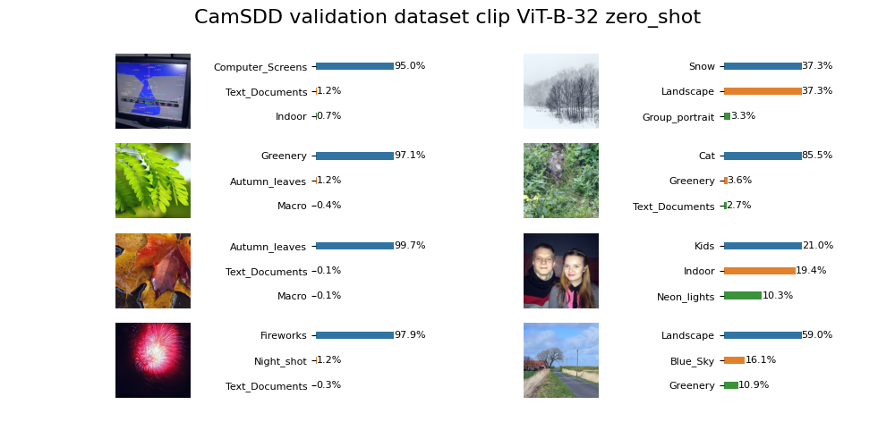
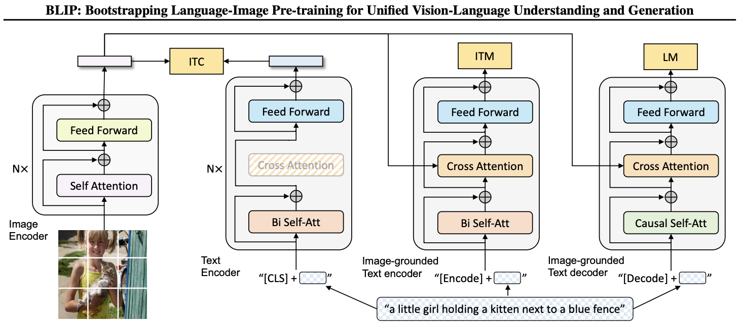
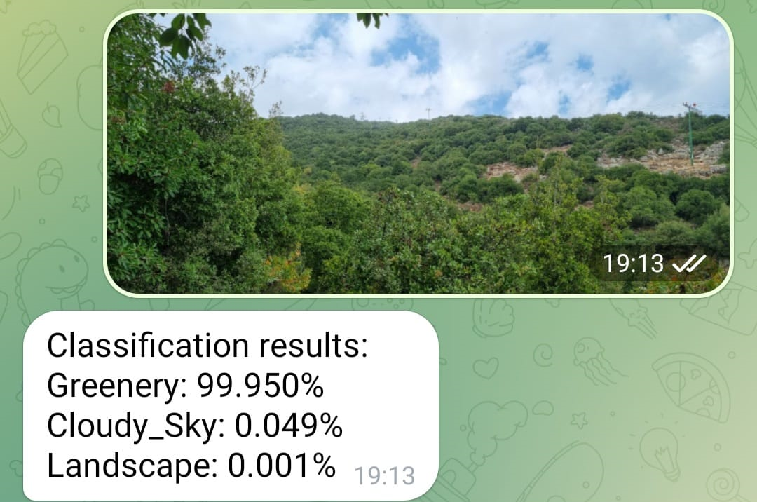
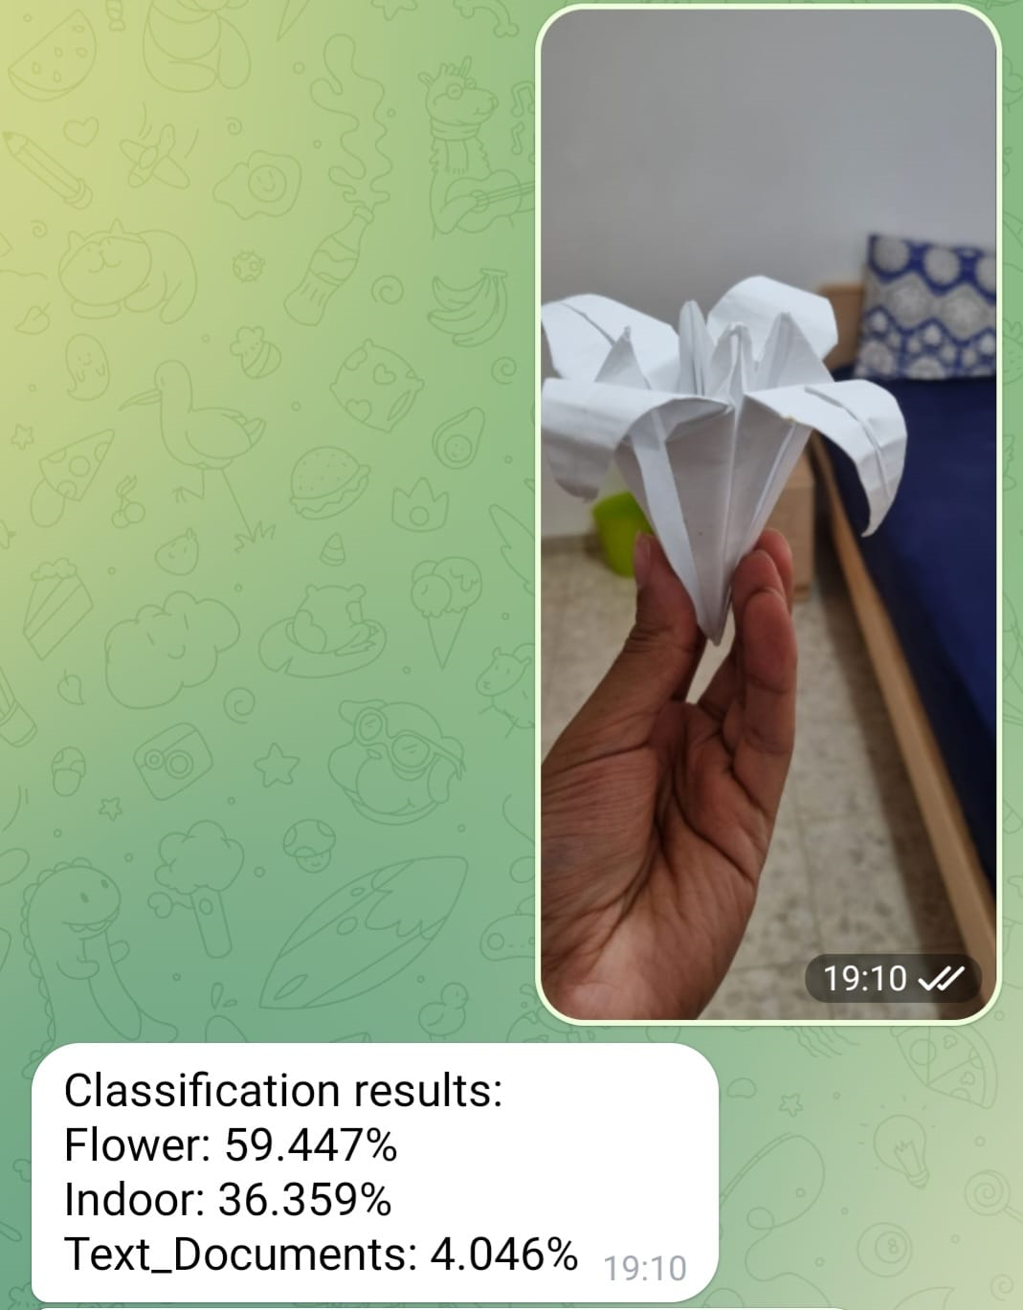
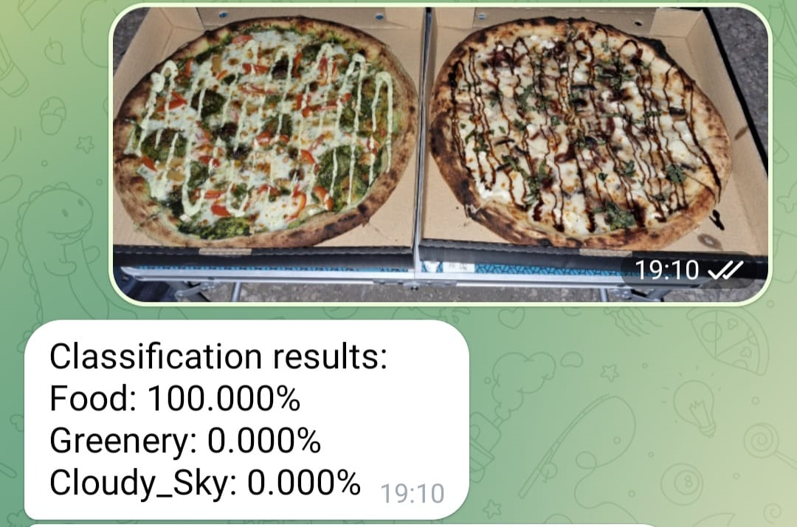
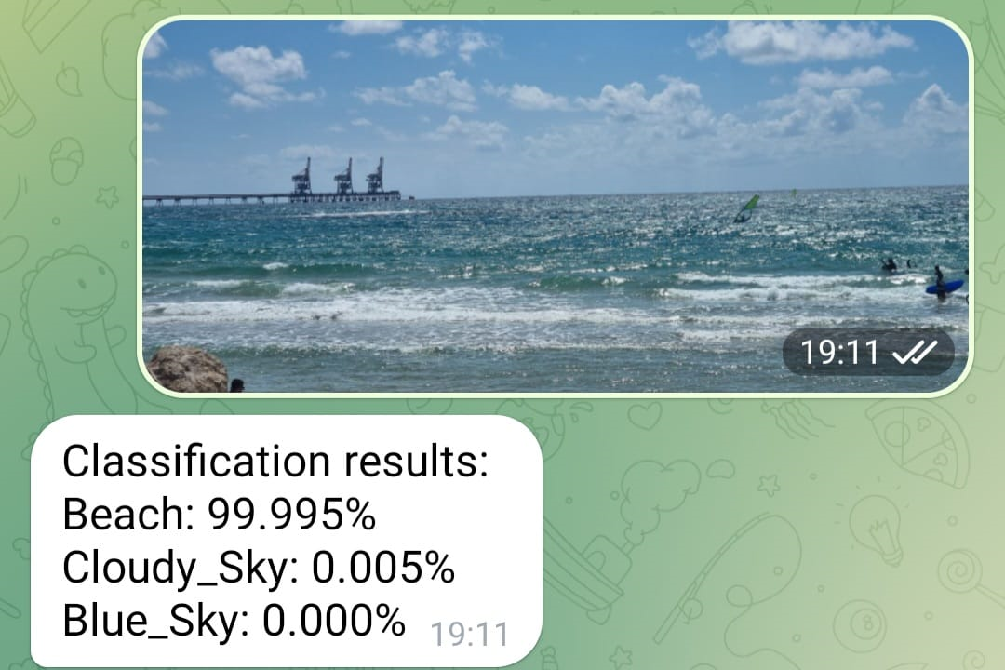
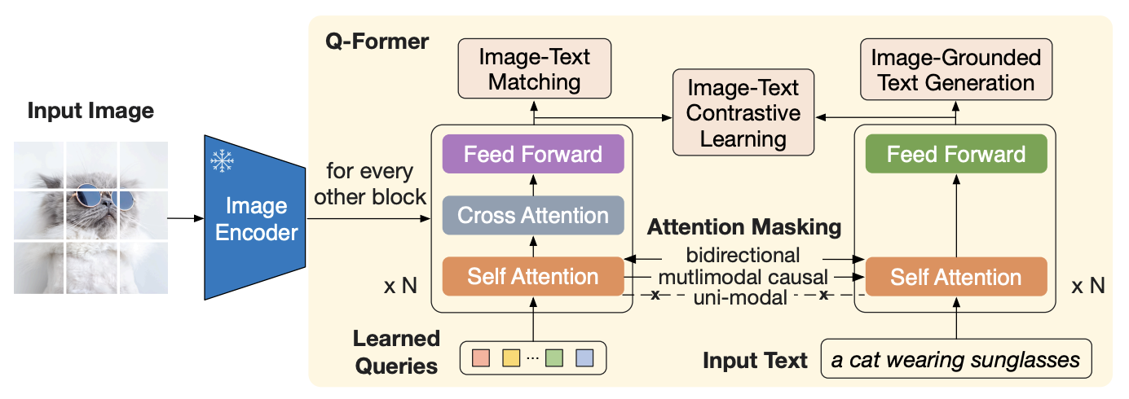

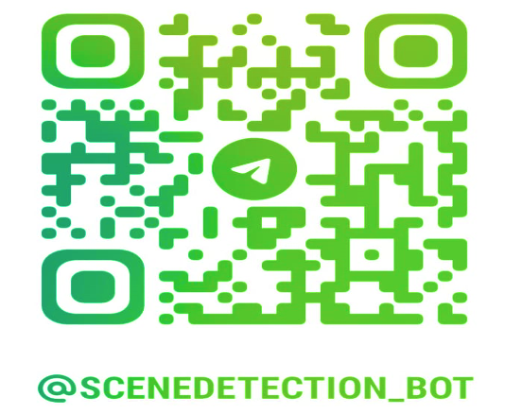

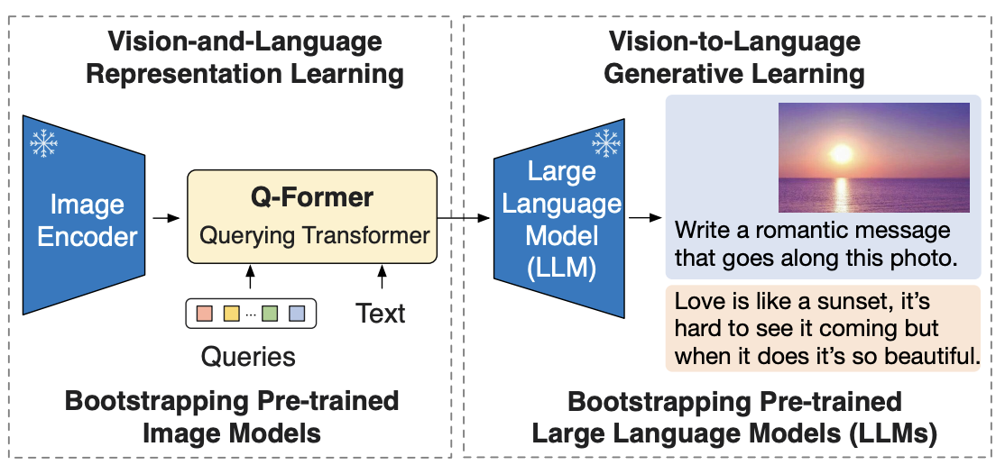
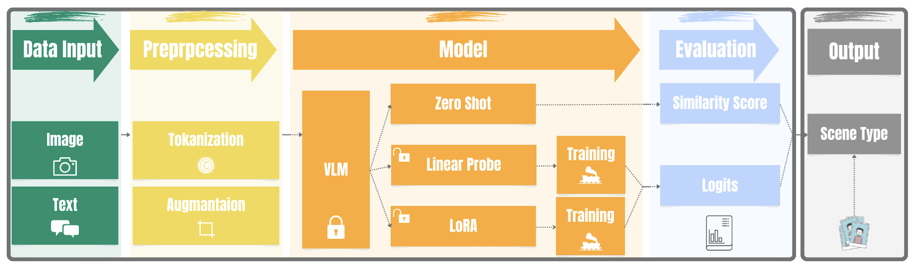


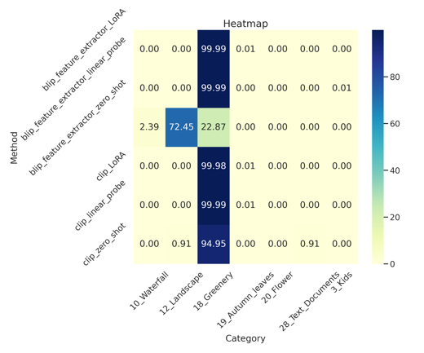
SCENE DETECTION ALGORITHM EVALUATION
BY VISION-LANGUAGE MODELS
Naor Cohen, Or Trabelsi
School of Electrical Engineering, Tel Aviv University
Introduction and Problem Statement
Related Work
Places365 |  | Places365
Method |  | Top-1 Acc. % | Top-3 Acc. %
CLIP | zero-shot | 37.65 | 58.00
 | finetuning: linear-probe | 47.75 | 61.51
 | finetuning: LoRA | 46.02 | 61.29
Capturing the perfect photograph relies on both hardware capabilities and intelligent software techniques. One such technique is Scene Detection, which automatically identifies the type of scene within a given image—landscapes, portraits, food, or low-light environments. This identification can serve as a foundation for image quality improvement in camera applications. We evaluated the performance of three different algorithms—CLIP, BLIP, and BLIP-2—using TOP-1 and TOP-3 accuracy metrics on real-world photos. Each algorithm was implemented as a zero-shot classifier and further fine-tuned with a linear probe technique. Our study leverages two datasets, CamSDD and Places365, to provide comprehensive insights into the efficacy of scene detection for improving image quality.
CLIP; Contrastive Language-Image Pretraining
Classifies images by mapping them and text labels into a shared embedding space. During inference, the image and text vectors are compared for similarity to determine the image's class. This eliminates the need for task-specific fine-tuning.
BLIP; Bootstrapping Language-Image Pre-training for Unified Vision-Language Understanding and Generation
Builds upon CLIP by adding a bootstrapping mechanism. It refines the image classifier by leveraging pseudo-labels generated from an initial CLIP model. This iterative process enhances the model's classification performance without requiring additional labeled data.
BLIP-2; Bootstrapping Language-Image Pre-training with Frozen Image Encoders and LLMs
An efficient pre-training strategy for vision-language tasks that leverage frozen pre-trained image encoders and large language models. It uses a lightweight Querying Transformer, trained in two stages, to bridge the gap between the visual and language modalities. The first stage focuses on representation learning from images, and the second stage aims for generative learning from language models. BLIP-2 performs state-of-the-art tasks like visual question answering and image-text retrieval while using significantly fewer trainable parameters.
CLIP Zero-shot
BLIP Zero-shot
BLIP-2 Zero-shot
Real World Results
Experience the Interactive Bot
https://t.me/SceneDetection_bot
Conclusions
Datasets
The commendable performance of the evaluated algorithms has been unveiled, with fine-tuning marking a significant stride forward. This advancement holds substantial potential for real-world photography applications through enhanced image quality. It acts as a catalyst in bridging the gap between vision and language understanding, thereby unlocking new avenues in scene detection. The beckoning of continuous innovation promises the advent of more sophisticated scene detection algorithms. As the journey towards enhanced image quality and profound scene detection continues, it is fueled by algorithmic excellence and fine-tuning prowess. The path ahead is laden with promise for further research and innovation, propelling the realm of visual understanding to new heights.
CamSDD; Initially, we engaged with the Camera Scene Detection Dataset (CamSDD), comprising over 11,000 images spanned across 30 different categories, serving as a cornerstone for our primary experiments.
Places365 Standard; To further enrich our data pool and bolster the project's depth, we integrated the Places365 standard dataset, renowned for its extensive collection of images, providing a more substantial ground for training and evaluating our models.
Method
Zero-Shot Classification. We introduced CLIP \ BLIP \ BLIP2 ZeroShot models for assessing image-text similarity based on their respective CLIP, BLIP, and BLIP2 architectures. These models encode and normalize both image and text features, subsequently calculating their similarity scores.
Linear Probe Fine-Tuning. We developed CLIP \ BLIP \ BLIP2 LinearProbe models, designed for classification tasks. These models contain a trainable linear layer appended to the respective pre-trained architectures. The trainer employs various optimization techniques such as SGD and is designed to report key training metrics like average loss and accuracy.
LoRA (Low Rank Adaptive). We also implemented LoRA-based models that adapt pre-trained architectures like CLIP and BLIP for our classification task without extensive retraining. LoRA adds a low-rank matrix to fine-tune only essential parameters, making it efficient and effective for adapting to new tasks.
 | Train | Validation | Test | Categories
CamSDD | ~11k | 600 | 600 | 30
Places 365 | ~1.8M | 36k | - | 365
Experiments and Analysis
CamSDD | CamSDD
Method | Top-1 Acc. % | Top-3 Acc. %
zero-shot
CLIP | 87.83 | 96.33
BLIP | 85.00 | 94.5
BLIP-2 | 82.83 | 95.67
finetuning: linear-probe
CLIP | 96.00 | 100.00
BLIP | 97.17 | 100.00
BLIP-2 | 97.17 | 100.00
finetuning: LoRA
CLIP | 96.67 | 99.83
BLIP | 96.67 | 100
BLIP-2 | 96.33 | 99.83
References from [1]
MobileNet-V2 | 94.17 | 98.67
Xception | 86.33 | 98.17
EfficientNet-B0 | 91.33 | 98.67
Image Preprocessing. Converts to RGB format → Resizes & Crops to 224x224 pixels → Convert to PyTorch Tensor → Normalizes the image using mean and std.
Text Preprocessing. Processes captions by appending a prompt and truncating words to a maximum length. Also, cleans up punctuation and spaces.
References
[1] Our work based on: Fast and Accurate Camera Scene Detection on Smartphones by Angeline Pouget et al, 2021
[2] Our work is inspired by: CLIPCAP (ClipCap: CLIP Prefix for Image Captioning, by Ron Mokady et al, 2021)
[3] Clip Model: Learning Transferable Visual Models From Natural Language Supervision by Alec Radford et al, 2021
[4] BLIP Model: Learning Transferable Visual Models From Natural Language Supervision by Alec Radford et al, 2021
[5] BLIP-2 Model: Learning Transferable Visual Models From Natural Language Supervision by Alec Radford et al, 2021
[6] LAVIS: A One-stop Library for Language-Vision Intelligence by Li, Junnan et al. 2023

